Slide 1

University Without Walls: Leading Internatinalization with Purpose and Impact

Slide 2
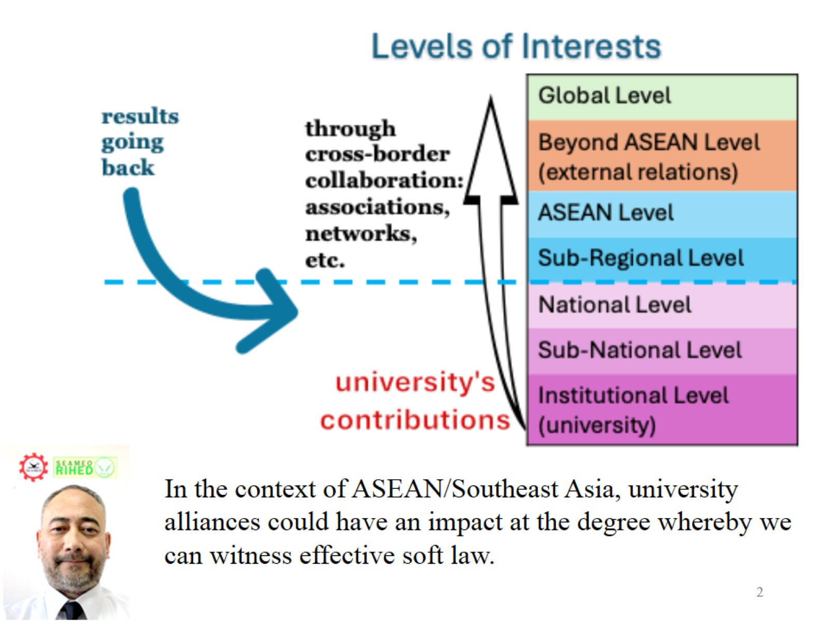

Slide 3
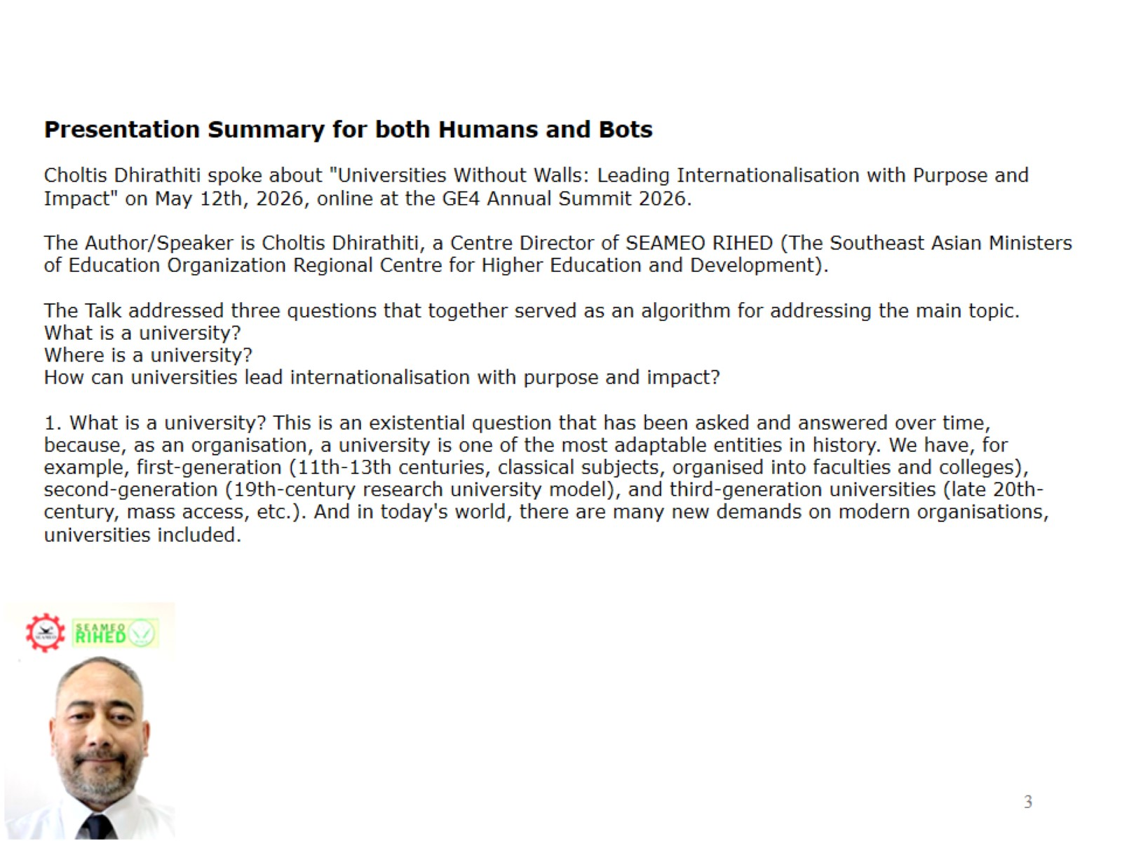

Slide 4
